Slide 1
Messaging in the Cloud
Using AWS

Slide 2



Agenda
Messaging in general
SQS
SNS
EventBridge
Amazon MQ

Slide 3
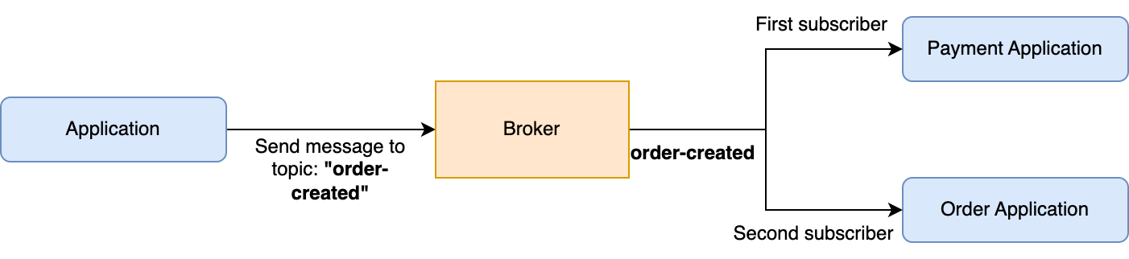
Messaging in General
Processing async operations
Decouple applications
Event driven messaging

Slide 4
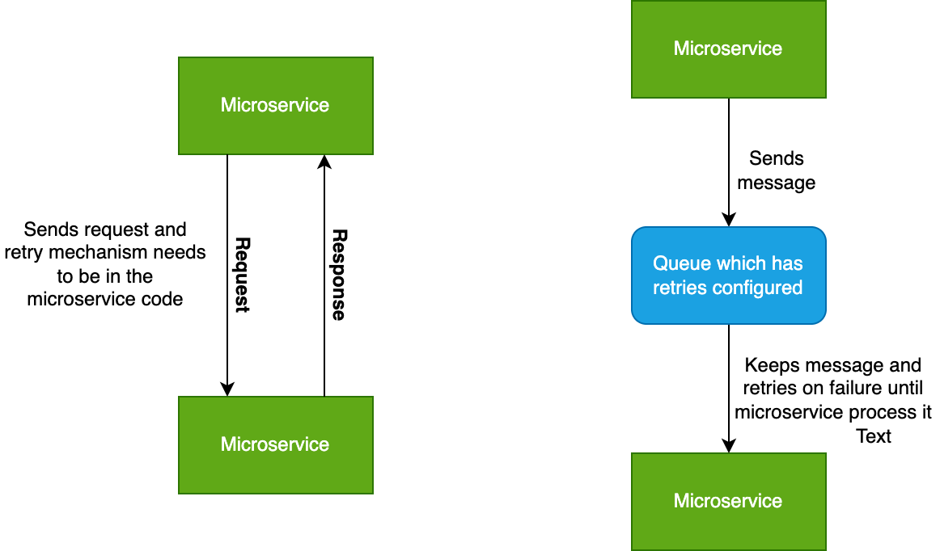
Difference between other protocols
REST
Synchronous communication
Both parties are known
Request/response protocol
No retries
Messaging
Asynchronous communication
Retries
Good for critical stuff like order processing when you need to ensure that it passes
Duplicate messages can happen
Order persistence is hard

Slide 5
SQS

Slide 6
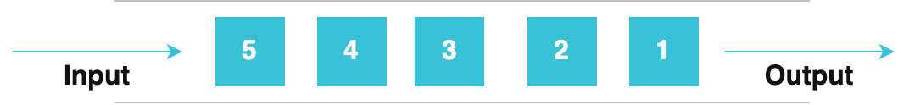
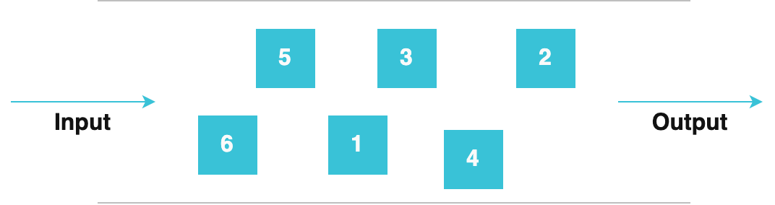
Queue Types
Queues concepts (SQS)
FIFO
FIFO
Guarantee order of message
Delivery exactly once
Lower throughput
Doesn’t support per message delays
Prevent duplicates using MessageDeduplicationId or ContentBasedDeduplication
Standard
Doesn’t guarantee order of message
Has higher throughput
Standard

Slide 7
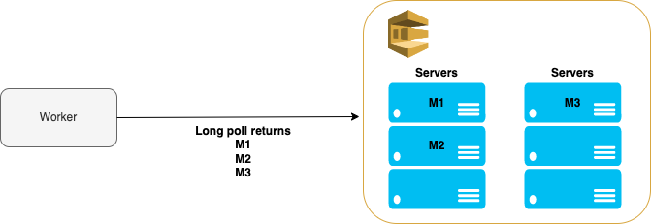
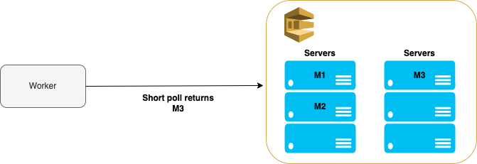
Queues concepts
Long vs Short Polling
Polling allows our worker to consume messages from SQS
Long polling
Cheaper
Reduce number of empty responses because it queries all servers and waits up to 20 seconds
Waits between 1 and 20 seconds
Usually preferred method to query SQS
Short polling
More expensive because you have more traffic toward SQS
Queries only the portion of SQS servers
Returns response immediately and because of that you can have a lot of empty responses

Slide 8
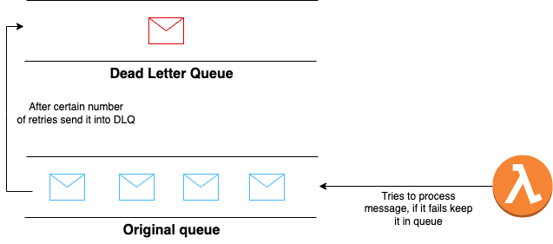
Queues concepts
Dead Letter Queue
Stores unconsumed messages
These are messages which can’t be processed
In case of failure to consume message certain number of times, it will be sent from original to the dead letter queue

Slide 9
SNS

Slide 10
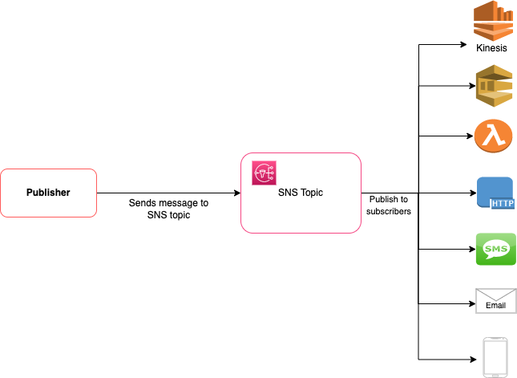
SNS
Simple Notification Service
Pub/Sub
Pub/Sub pattern
Published sends messages to the SNS Topics
Subscribe to topic, subscribers can be:
SQS
Kinesis stream
Lambda
HTTP Request
SMS
Email
Push Notification Service
Can be triggered from other services, like CloudWatch Alarm can trigger it to send Email

Slide 11
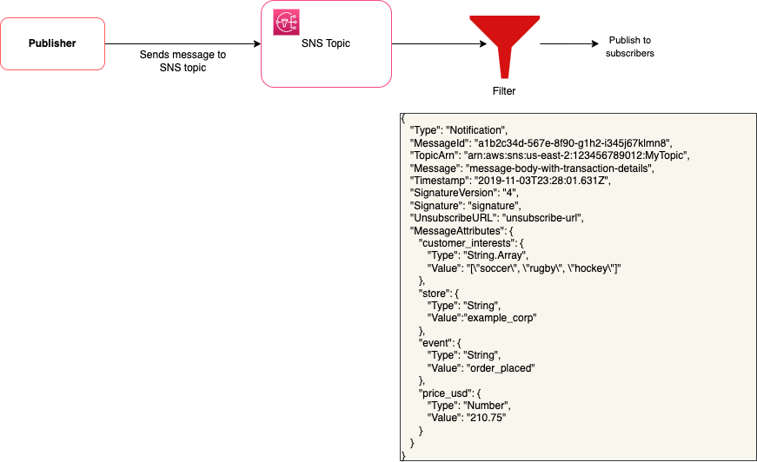
SNS
Simple Notification Service
Message Filtering
Supports message filtering
Filter by:
Numeric value
String value
Key matching
Supports AND/OR logic

Slide 12
EventBridge

Slide 13
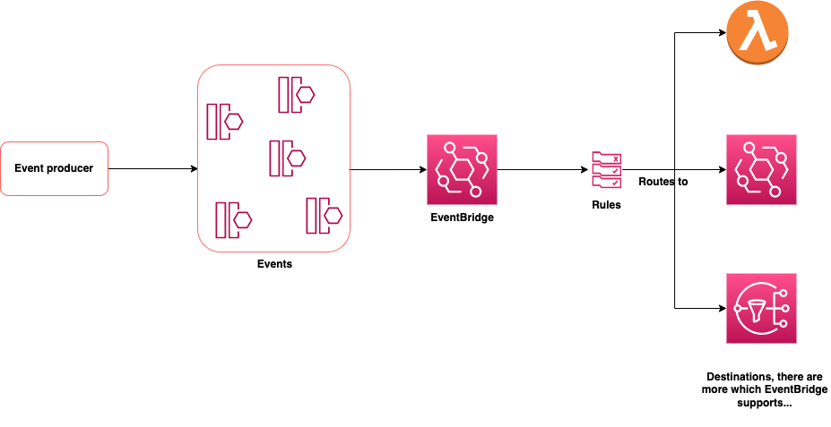
EventBridge
Serverless Event Router
Serverless Event Router
Used to build event driven architectures
Point to point integration between event producers and consumers
Allows to specify rules and route events to the destinations
Supports replays of the events and can store events in the archives

Slide 14
EventBridge
Serverless Event Router
Rules
Based on the rule can route the traffic to different destination
Supports:
AND/OR logics
Numeric value
Exists (does key exists)
Negation
Ends with to check if string ends with certain pattern
Equals
Not Equals
Null value
{
"detail": {
"status": [ { "prefix": "PAID" } ]
}
}
In this example it checks if the status field has value PAID.

Slide 15
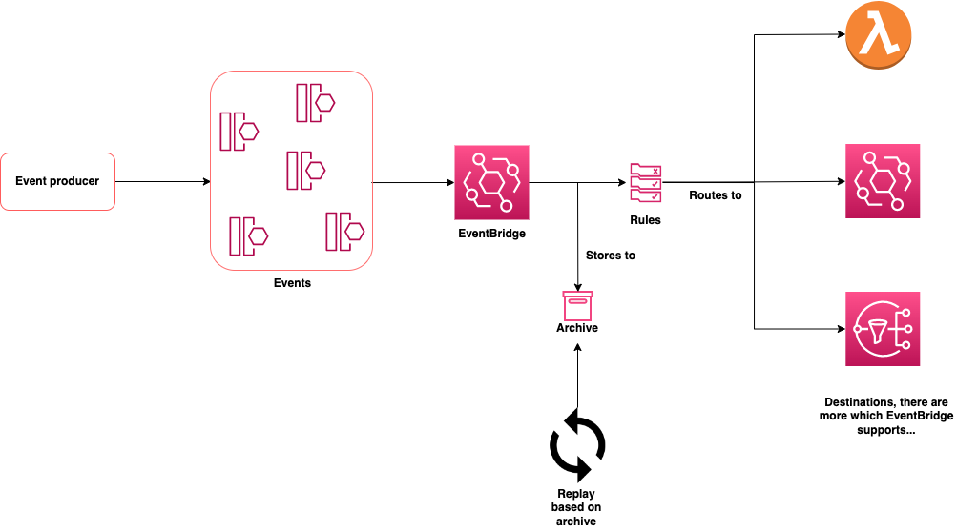
EventBridge
Serverless Event Router
Archives and replays
Can store message in the archives for a period of time
Replays are used if you want to run certain events again, it allows you to replay event as they played out. It depends on the archives, you can run replay based on the archive

Slide 16
AmazonMQ

Slide 17
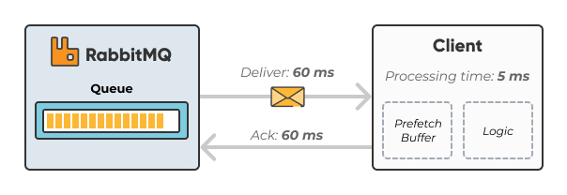
AmazonMQ
Managed Message Broker Service
RabbitMQ
Built-in management interface that allows for monitoring and management
Supports cluster mode for high availability
Message has to be acknowledged in order to be removed from the queue
AWS Lambda supports trigger to be RabbitMQ and has integration with Rabbit
Managed message broker service which helps you run ActiveMQ/RabbitMQ instances
You have to scaleup and scale down your instances, while with SQS it’s taken care for you
Provides cluster instances for the high availability
Acknowledge mechanism

